Slide 1


Critical Cybersecurity Case Studies
Notes:
- This is to provide additional motivation and to refer back to it as we teach future core topics. This way, students will clearly understand that the theory they are learning is entirely applicable in practice and potentially give some excitement at the beginning (I mean, how does the US Pentagon get hacked?…). As a side point, the rest of this lecture can be used to discuss some bases around security, hackers and threats and perhaps authentication (including entropy, physical tokens, two-factor authentication (2FA) and biometrics).
- Topics:
- Cybersecurity Case Studies
- Security, Hackers and Threats
- Authentication

Slide 2
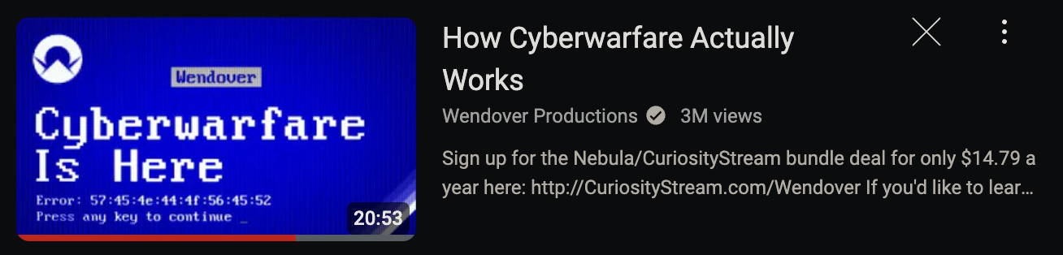

https://www.youtube.com/watch?v=U_7CGl6VWaQ&t=1052s&ab_channel=WendoverProductions

Slide 3
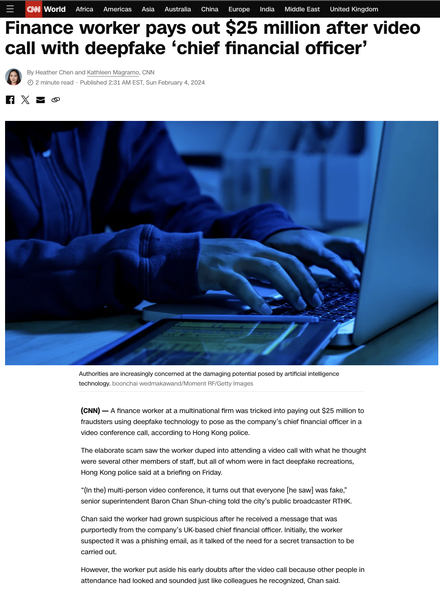
https://edition.cnn.com/2024/02/04/asia/deepfake-cfo-scam-hong-kong-intl-hnk/index.html

Slide 4
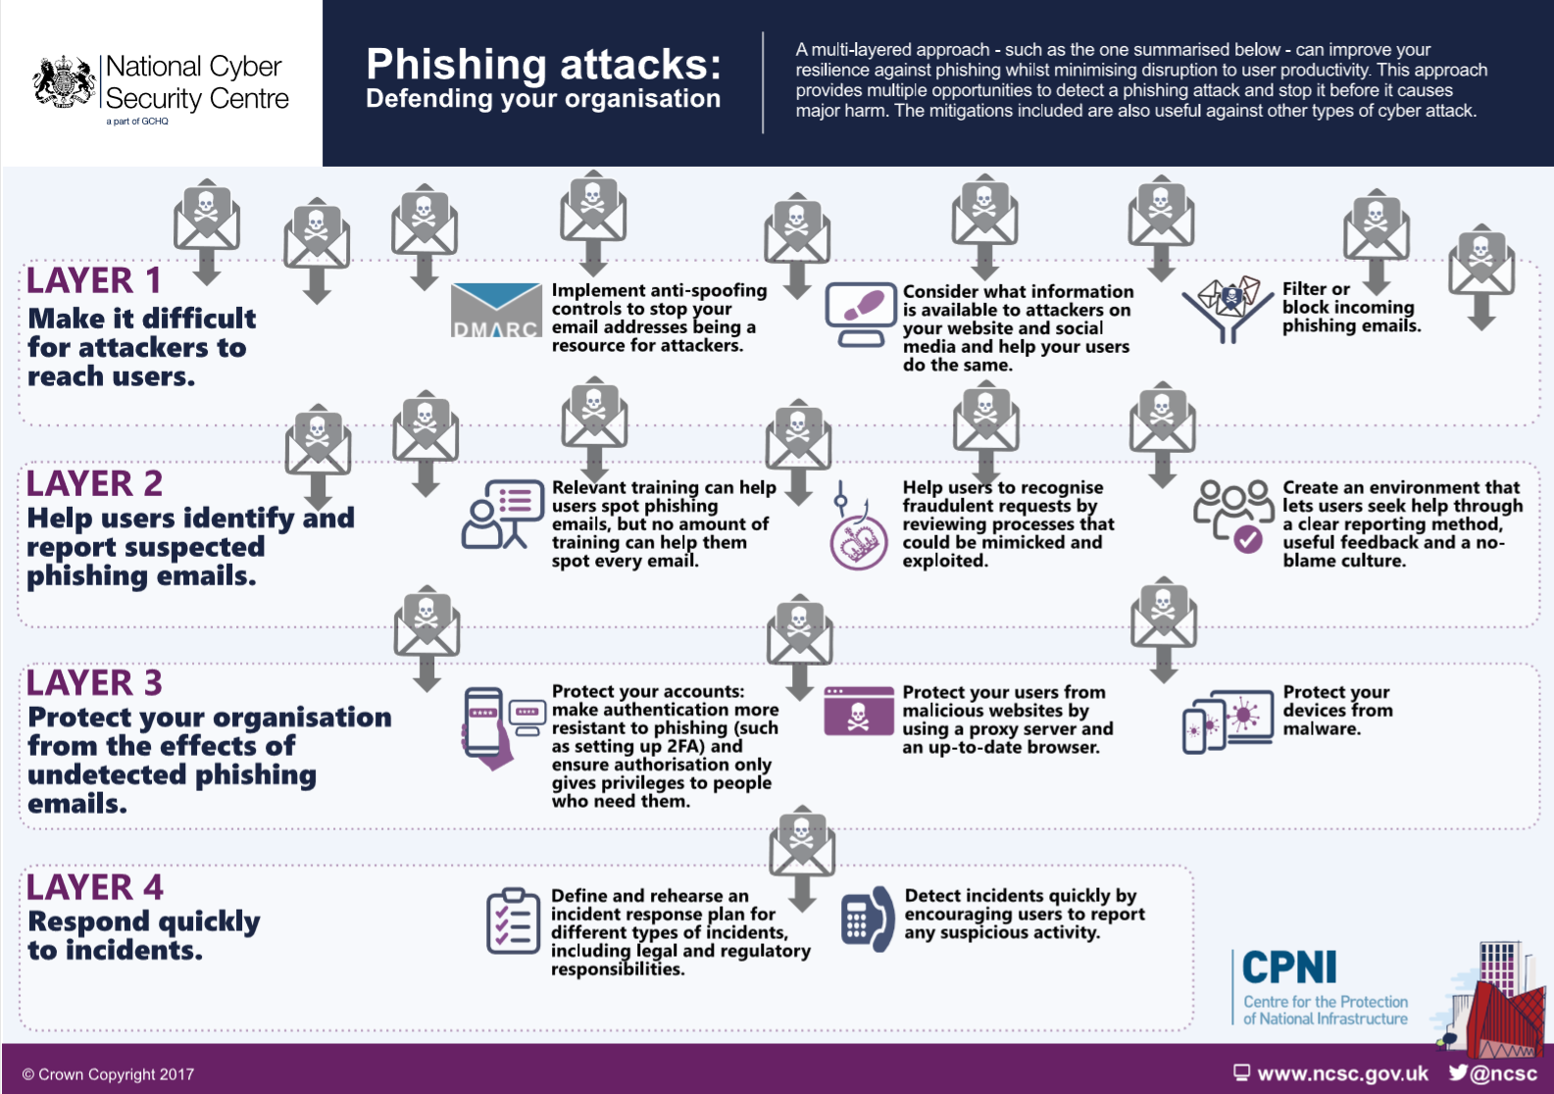
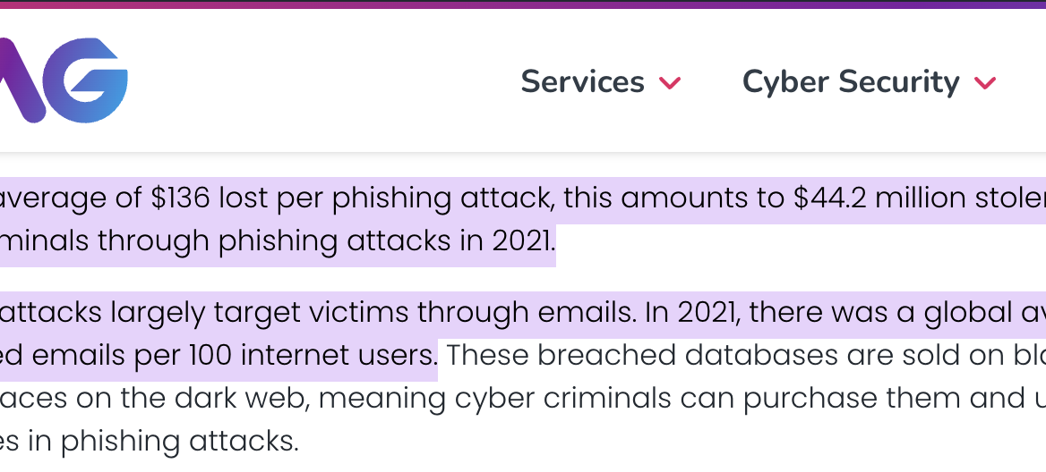
https://www.ayrmer.co.uk/blog-articles/Cyber+security+advice/

Slide 5
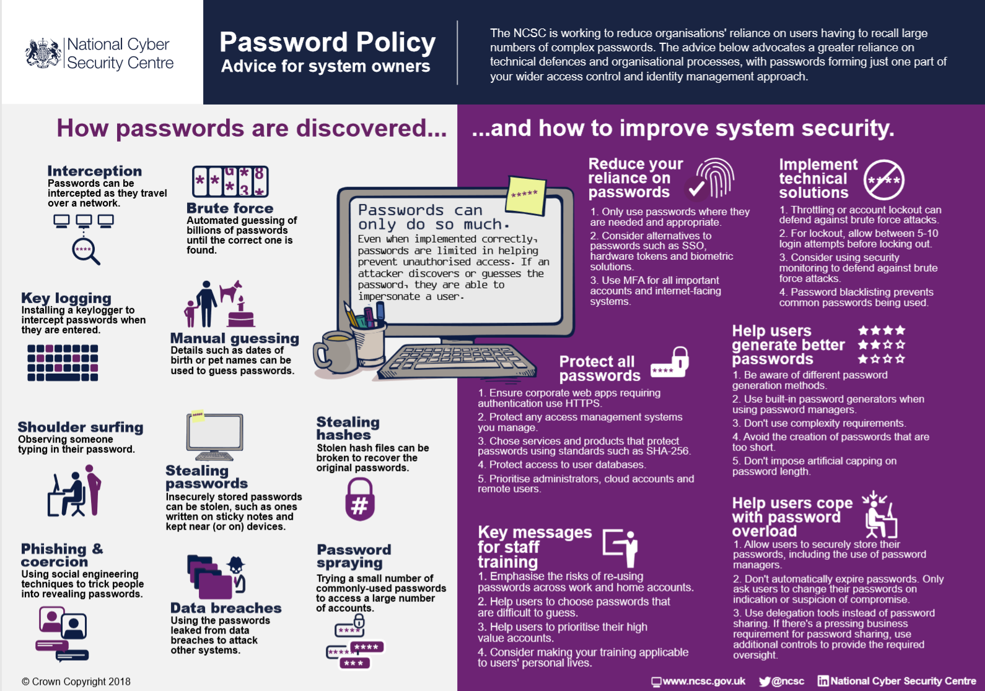
https://www.ayrmer.co.uk/blog-articles/Cyber+security+advice/
Notes:
authentication (including entropy, physical tokens, two-factor authentication (2FA) and biometrics).

Slide 6

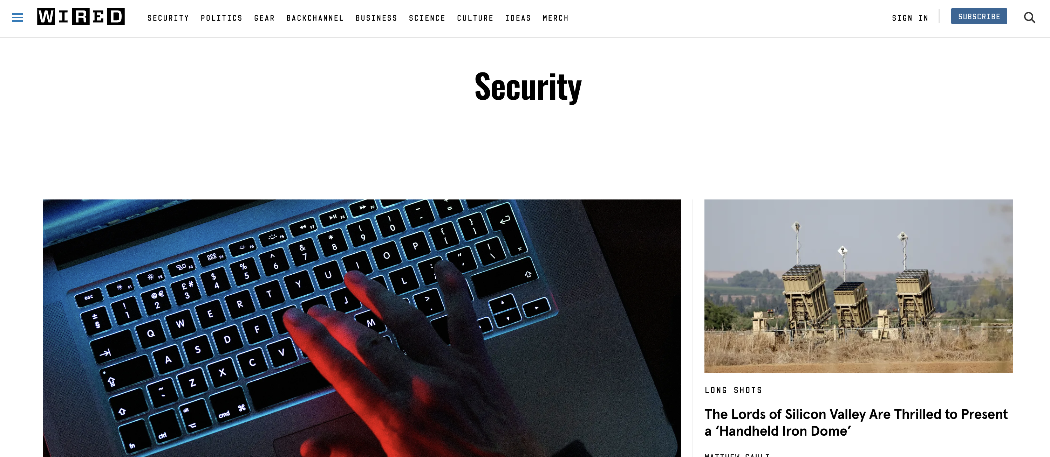
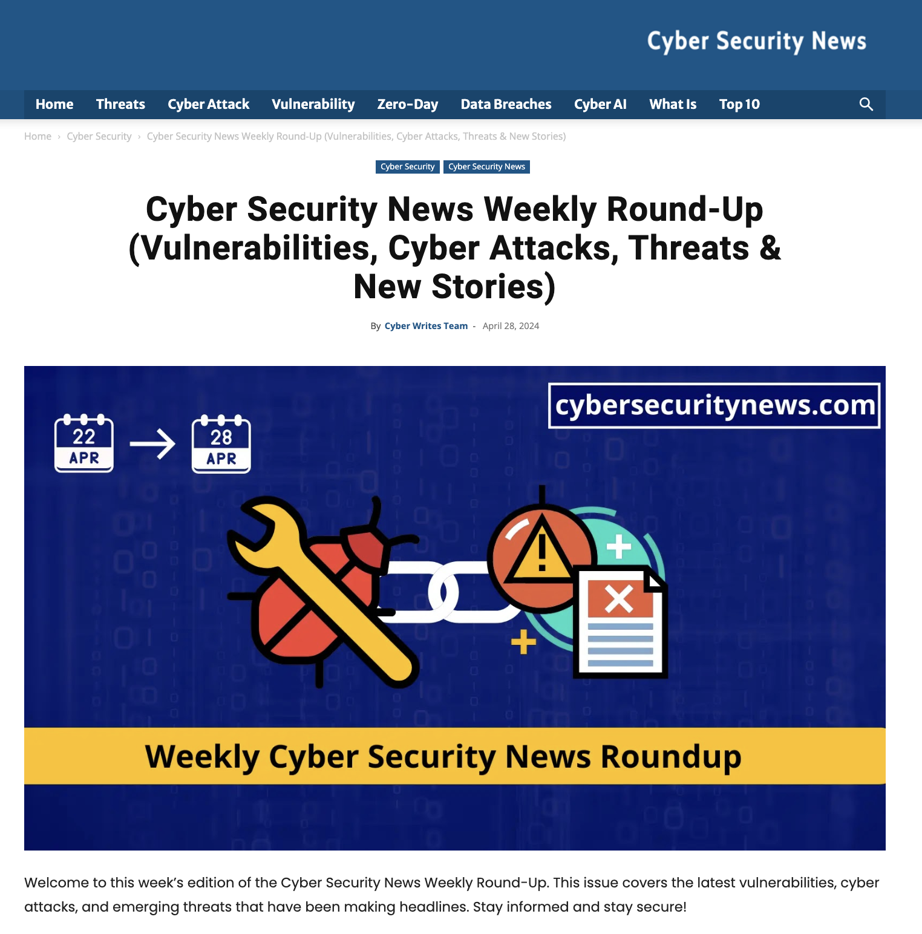
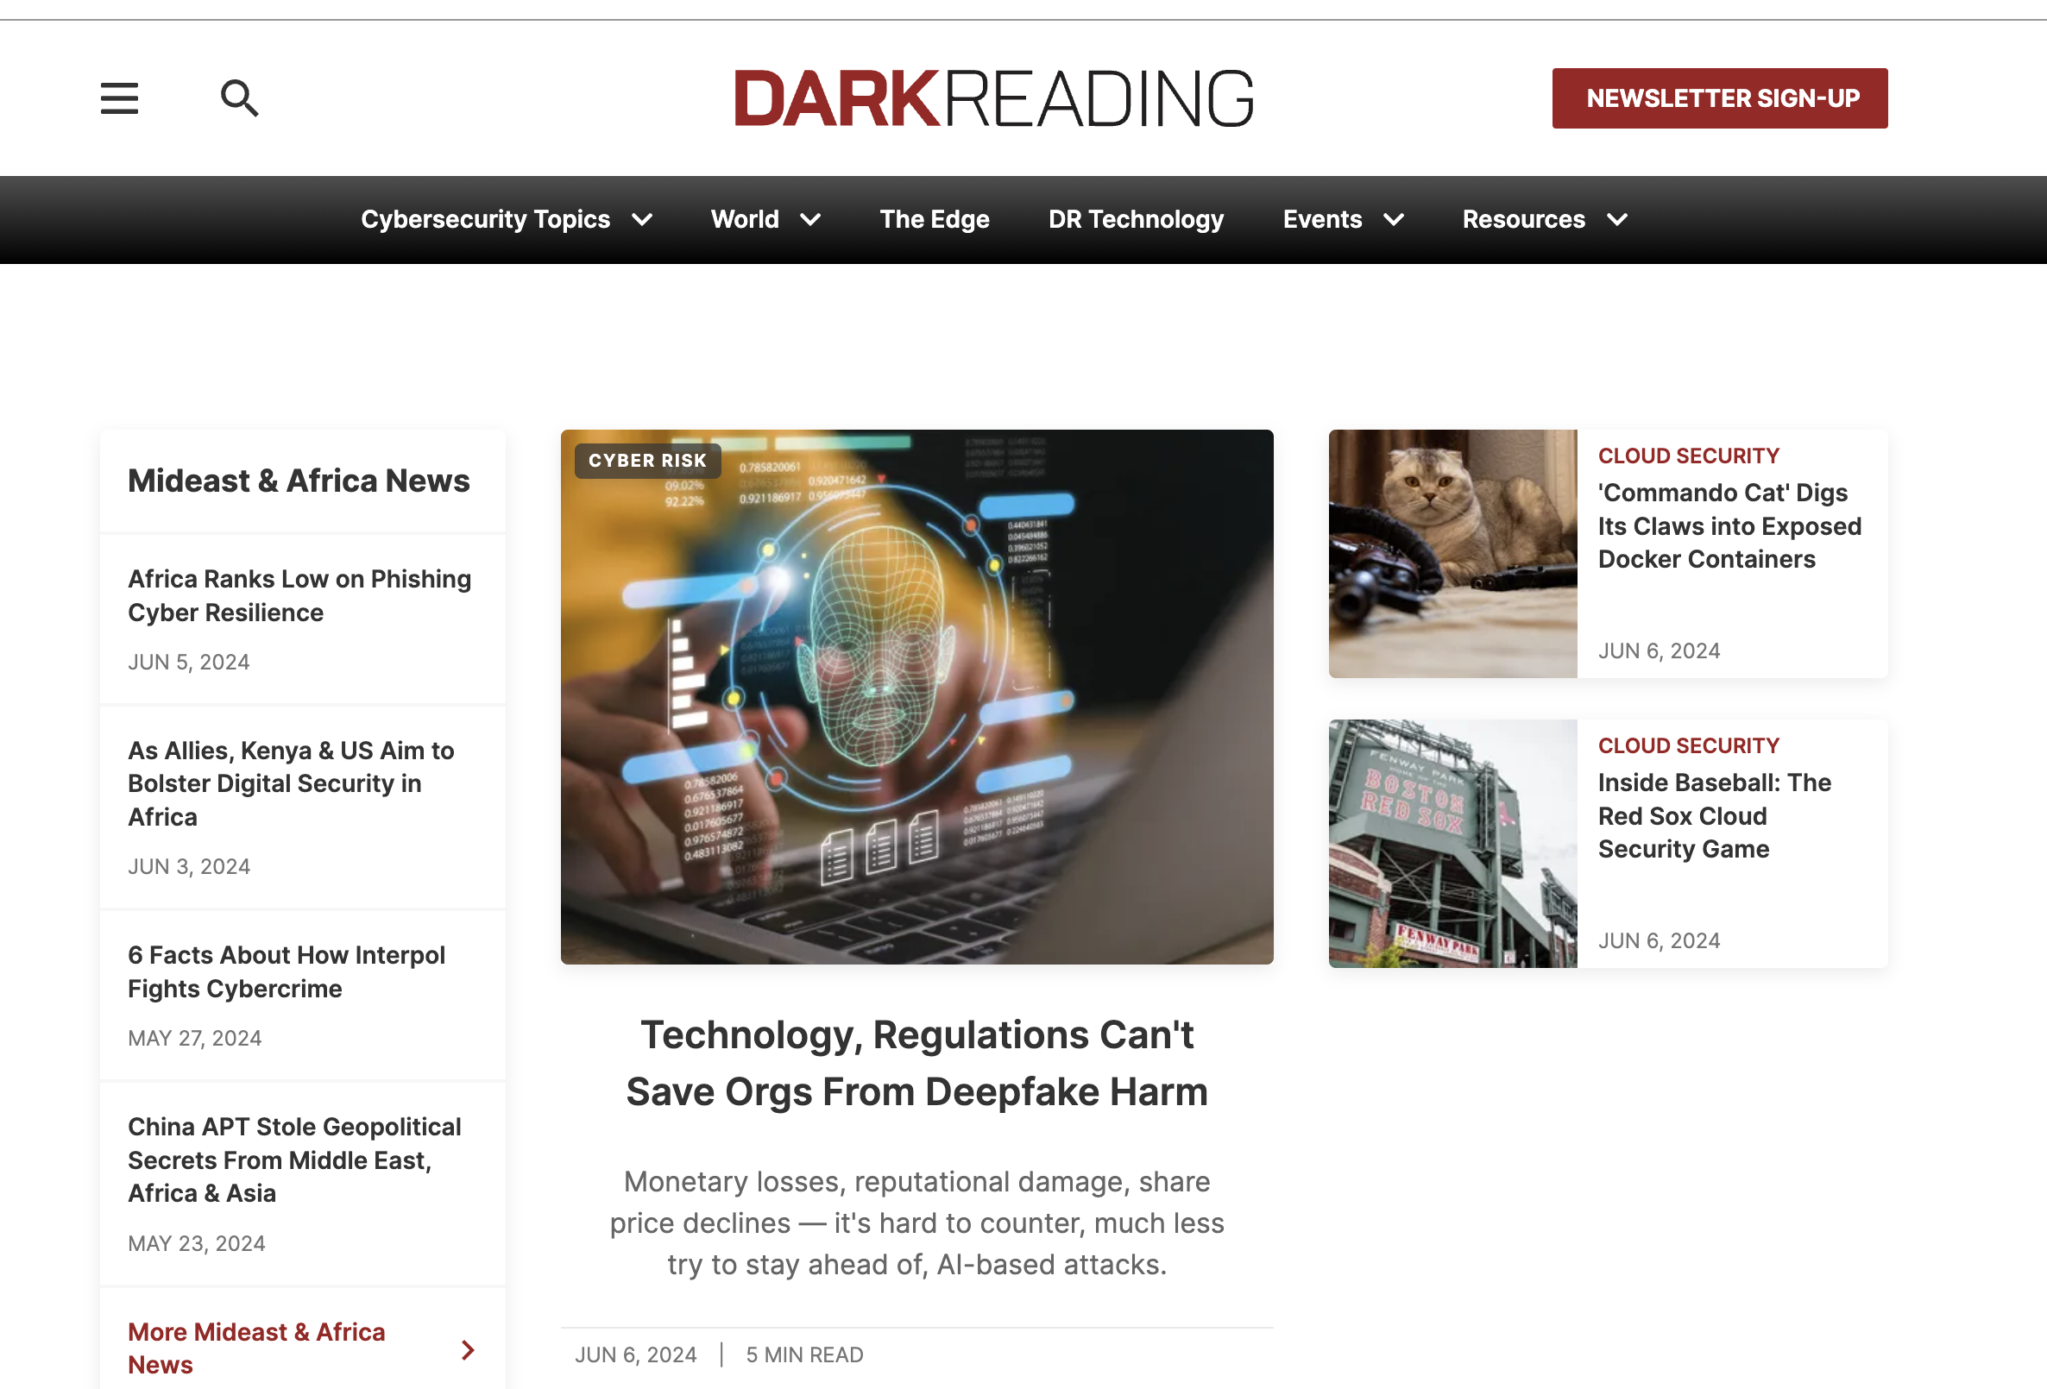
Newsletters
(Don’t Forget)
Notes:
Whole world of competition

